Slide 1
Jacques Vallee Report from the field PART ONE THREE CASE STUDIES in BRAZIL
Caso Antonio, 1975
Caso Tisiana, 2004
Caso Manoel, 1999

Slide 2
THREE CASE STUDIES: a reality check
In late July and early August 2015, a friend and I travelled to the « Northeast » of Brazil in support of two focused, personal research projects:
Field work and document review in a dozen cases of close encounters with UFOs in an area extending from Fortaleza to Cobral (west) and Quixada (south)
Investigation and tracking down of witnesses in an old (1970s) series of events of a « spiritualist » nature in the « Interior » northwest of Salvador da Bahia.
This presentation focuses on three selected cases from the first part of the trip. There were no sponsors and no contact with local UFO groups.

Slide 3
The setting
Fortaleza is a city of 4.3 million people, 3.5 degrees south of the Equator, served by a modern international airport
(7-hour flight from Miami).
The « Interior » in this part of Brazil is primarily agricultural, well-served by a network of roads and with modern communications, although living conditions look primitive and obsolete by North-American standards.
No extensive forests, no «jungle» (No Amazon!)

Slide 4
One finds a rich background of spiritualism, Umbanda and religious (80% Catholic) beliefs and practices

Slide 5
1. Caso Antonio 3 Nov.1975

Slide 6
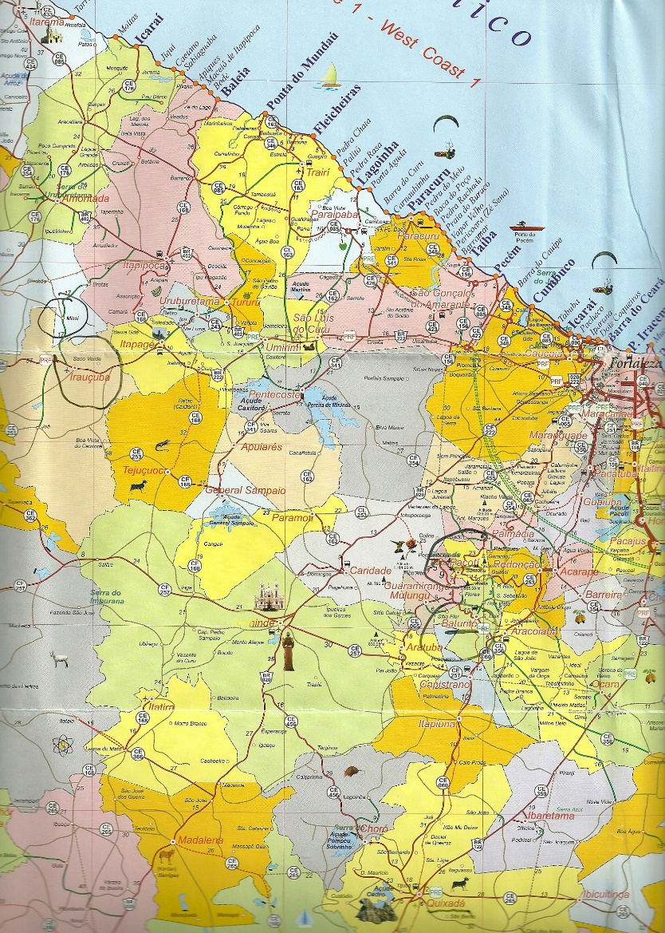
Caso Antonio (3 Nov.1975)
small village, a 2-hr drive from Fortaleza.
The case is little-known in Brazil.
It involves the death of a farmer who was growing cotton on his property.

Slide 7
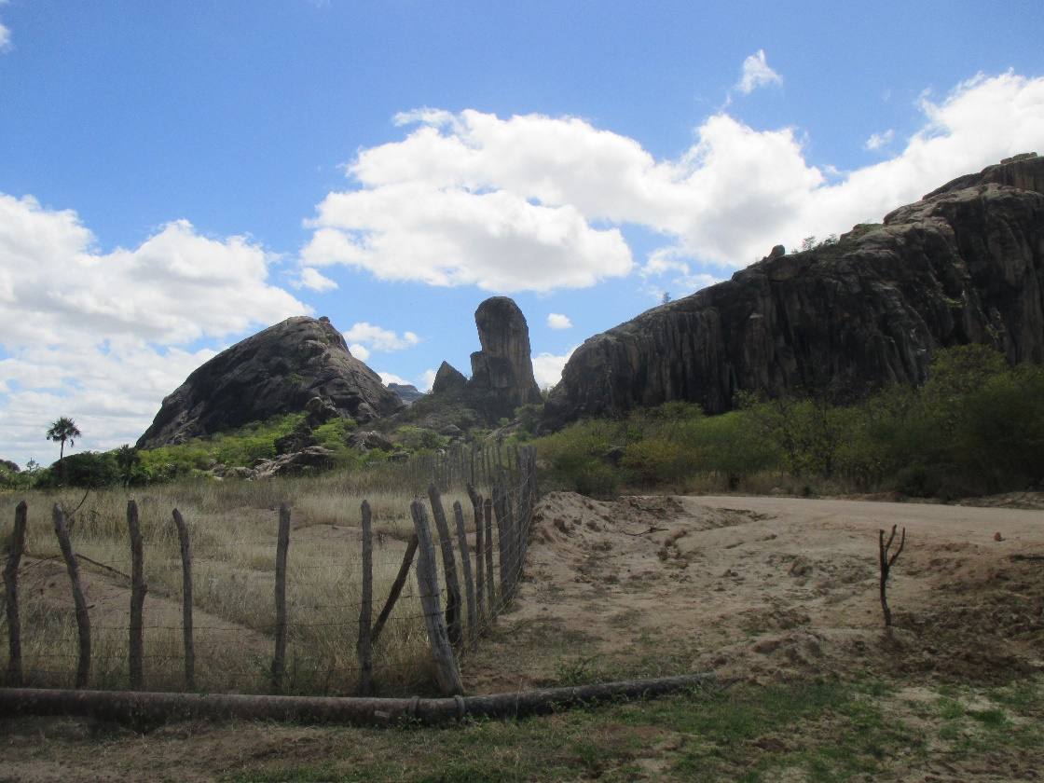
The site (farm)
The region is spectacular, with granite and basalt formations.
Rich plantations, palm trees.

Slide 8
Summary of the case
Antonio was working on the property. From a distance, two of his children, about 11 yrs old, saw an object (bright white ball) that came down to the height of a tall tree
It emitted two vertical beams (one white, one red) in the general area where the father was.
He did not come back for lunch by 1 pm.
He was found dead on the spot.

Slide 9
Family members and neighbors recall the case
We located and interviewed a woman (Marijosé) who had married one of the sons and remembered the incident.
She verified the details, having seen the body (but not the object itself).

Slide 10
Details of injuries
The victim presented the following:
Part of the head burned black
Missing flesh on forehead
Hole on back of the neck, with some dried blood
Right shirt collar burnt and fused (artificial cotton, polyester)
His knife was found several m.away
Both arms and feet were burned
Deep « sunburns » on cheeks
His son discovered the body, with his father’s shoes on the ground some distance away.
There was no autopsy, which is typical of this region at the time.

Slide 11
One more witness (nephew)
While tracking down another case we managed to locate a nephew of Antonio and we interviewed him the same day.
Name: Francisco
He recalls the time was 1 pm. He confirmed his uncle’s arms were burned, as well as the forehead.

Slide 12
2. Caso Tisiana 2004

Slide 13
Caso Tisiana, 2004
a semi-rural area east of Fortaleza, a suburb.
The witness was a pregnant woman close to delivery.
One night she saw a very bright light behind the window.
She and her husband subsequently discovered a spiral reddish mark on her abdomen, which led them to report the incident.

Slide 14
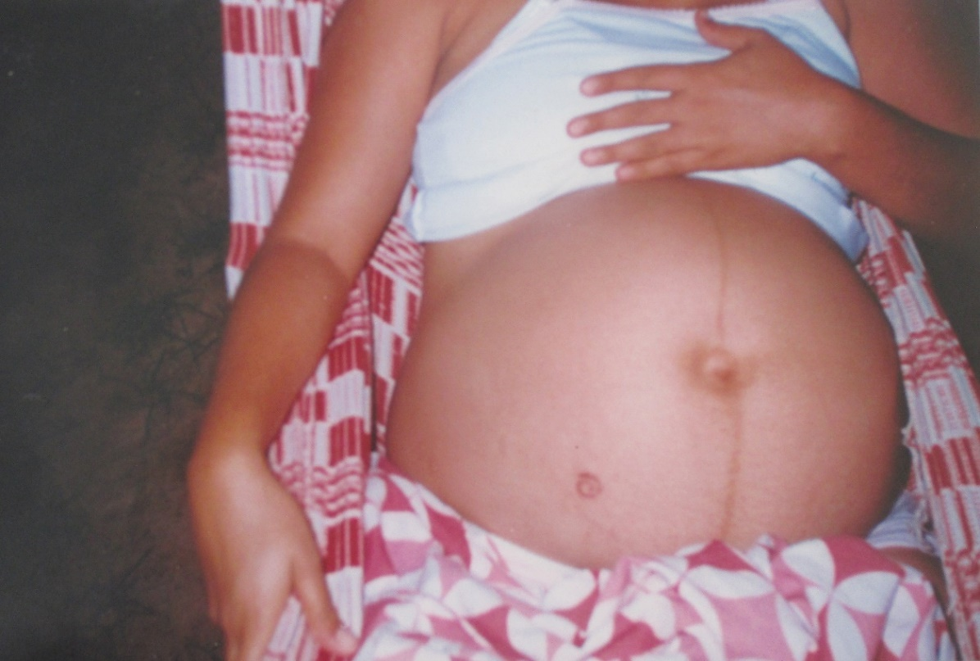
Skin mark on the abdomen
The baby was born a week later. The same mark appeared, smaller.

Slide 15
Prior history
When she was a little girl, Tisiana lived in a « sitio » (country property) and used to walk outside with her maid.
A big « light » once came close to them, scaring them.
They ran into a house.
Everything came back to normal but they continued to see lights.

Slide 16
3. Caso Manoel 22 Oct.1999

Slide 17
Caso Manoel 22 Oct. 1999
Manoel, 47 years old at the time.
The site was a country estate, about an hour outside Fortaleza.
He was attending a family event, a birthday party.
Going outside at 4:30 am, he was lifted by a beam of light and « lost » four hours.

Slide 18
Caso Manoel: initial findings
Other people looked for him at noon and found him unconscious.
He had been dropped 50m away.
He had a cut over the right eye, was bleeding and held a 10 cent coin in his left hand.
His necklace was no longer around his neck but was in his right hand.
He was taken to a doctor in Sao Paulo and interviewed (photo).

Slide 19
Caso Manoel: injuries
Manoel had multiple cuts (which didn’t hurt, and were cauterized) on the left side of his body.
He had a hole in his left hand that was painful and took a long time to heal, with fluid exuding from the wound.
He felt drained of energy.
He didn’t understand why he had a 10 cent coin in his left hand and what happened to his necklace.

Slide 20
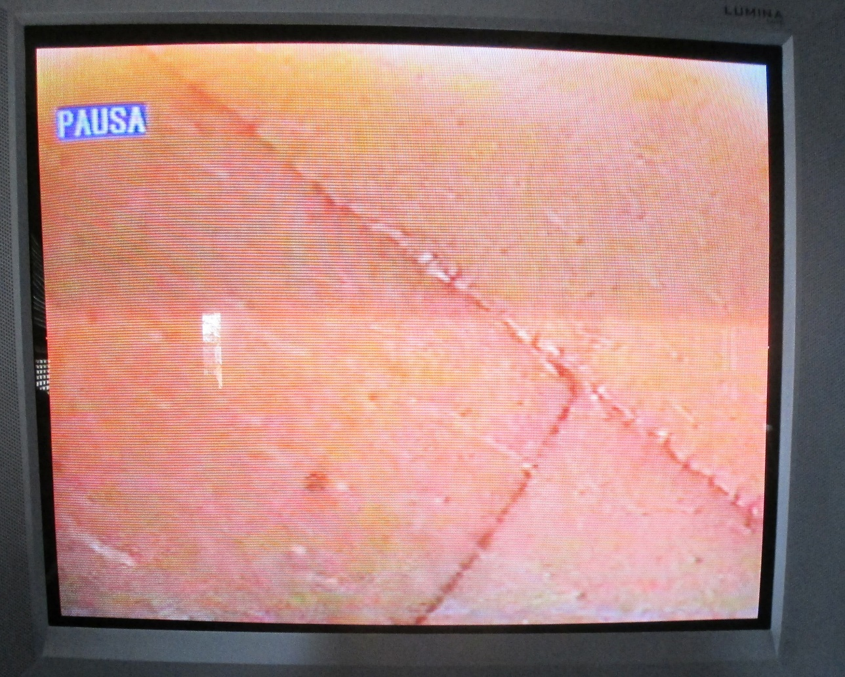
Caso Manoel: other details (within 24 hours)
There were a number of clearly-patterned incisions -- with the appearance of having been stitched and cauterized (no blood, no pain).
He is retired now, after working as a driver for a chauffeur service.
He recalled the sensation of being lifted, and later dropped.
He now wishes he could contact « them »

Slide 21
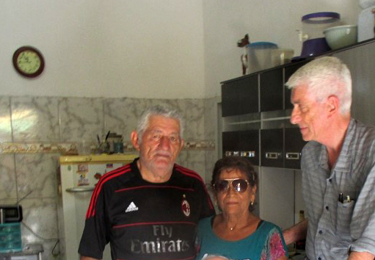
Caso Manoel: personal visit, 27 July 2015
Manoel is Catholic, now 69 yrs old.
I met with him, his wife and grandson at their home.
His health has been good over the years although he smoked a lot and recently needed a heart operation.
He doesn’t feel his personality has changed. The scars are still visible.
He has dreams of beings taking him away through the wall.

Slide 23
PART TWO Report from the field: TWO CASE STUDIES in FRANCE
Near Paris, Sept. 2010
- Near Paris, Oct 2016 and in Brittany, July 2017

Slide 24
Paris suburb case, 14 Sept. 2010
Middle-aged woman, very active
Modern building, high floor
Shortly before midnight
Observes an egg-shaped light
passing slowly along the balcony
about 10m (30 feet) away.
Initial investigation: Mr. Gérard Deforge
Gendarmerie report 17 Sept. 2010
Photo by J. Vallée.

Slide 25
Paris suburb case, 2010 : Two Photographs
The witness takes two photographs as the object drifts by slowly,
very close to the balcony (open window).
She testified before a group of French UFO investigators on
21 Sept. 2010. I asked her to request an uncut film from the
development company. We secured the camera.
The film did not show the object. I took the camera and the
film back to California for further study.

Slide 26
Paris suburb case, 2010 : visual Reconstruction (credit: G. Deforge, J-P Venturini)

Slide 27
Film Analysis
The analysis used a Nikon LS 4000 scanner connected to a MacBook Pro.
Film images were scanned at 5782 x 3940 pixel resolution (color: 8 bit depth)
resulting in files of 65.3 megabytes per image. After scanning, the images were
analyzed using PhotoShop "curves" and other software.
The frames that correspond to the witness’ description of her actions are the last two frames on the film,
While they seemed to be blank to the eye, it turned out both frames had indeed been exposed.
Frame A: Faint street lights (or car headlights) are visible in the
distance, similar to those on frame 14A which is a night landscape. We noted a road.
There is no other object on the frame.
Frame B: There is a very small light (possibly car headlights) on the
edge of this frame, but there is no other object on the frame.

Slide 28
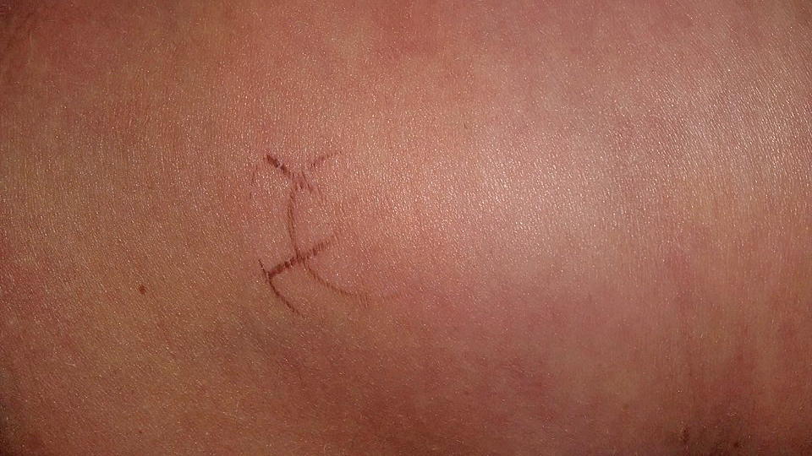
Recent, Multiple-witness case in France
Paris, October 2016:
The witness notices a mark on her hip. It fades in about a week
In Brittany, July 2017:
The witness contacted me in Sept.2018.
In July 2017 she had been driving with her daughter and another girl (teenagers)
Bright early afternoon
Very large gray disk flew slowly, low over the car.
Picture taken with cell phone
(two-year old Samsung)

Slide 29
The actual photograph doesn’t match what the three witnesses saw…
The photograph shows a dark
object much higher in the sky
(at the base of the clouds)
with a 6-branch structure.
The investigation continues
in France.

Slide 30
An exceptional case: work in progress
This unique case links together (1) skin mark, (2) close encounter on open road and (3) photograph discrepancy.
We may be able to establish if the
dark area on the cloud (lower right)
is a shadow of the 6-branch object.
This could give us dimensions and
altitude.
?

Slide 31
Thank you !
For more information:
www.jacquesvallee.net

