Slide 1
WHAT DO WE KNOW about the material composition of UFOs ?
Work in progress: a status report
Dr. Jacques Vallee, Documatica Research, LLC.
documatica@aol.com
Dr. Garry Nolan, Stanford University School of Medicine
gnolan@stanford.edu
Paris, June 2017

Slide 2
Three categories of UFO-related materials
(A) Metallic samples recovered from molten masses observed to be ejected by unidentified aerial objects,
generally in situations where they become unstable. They are the topic of this presentation.
(B) “implants” ranging from bits of wire to small structured devices, sometimes encapsulated in organic
material, extracted from the body of witnesses following a close encounter.
(C) Large structural pieces claimed to have been found at the site of catastrophic crashes of craft, including
what appears to be part of the “skin” of the object. The literature speculates about the recovery of
propulsion systems, interior devices and even biological entities associated with these craft.
While the Roswell case remains the popular prototype of such stories, a dozen other sites are quoted by various authors. The bulk of this material is said to be sequestered in aerospace facilities under special categories of security, outside the ordinary clearance system.
Several studies by private parties identify significant components with terrestrial isotopes in radically
altered ratios : a fundamental challenge and an opportunity in terms of high-technology frontier R&D

Slide 3

Isotopes

Slide 4
What are Isotopes ? Some definitions
In order to understand what we are about to discuss in this document it is not necessary to know complex notions of chemistry but it is useful to begin with a review of a few definitions.
Isotopes are different forms of a single chemical element.
Isotopes are atoms with the same number of protons in the nucleus, but differing numbers of neutrons. In other words, they have different atomic weights. There are 275 isotopes of the 81 stable elements. There are also over 800 radioactive isotopes, some of which are natural and some synthetic.
The chemical properties of isotopes of a single element are nearly identical.
BUT the physical properties of isotopes are different from each other since these properties often depend on mass. This difference may be used to separate isotopes of an element from each other by using distillation and diffusion.

Slide 5
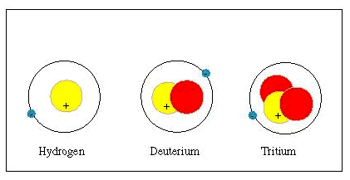
Simple example: Hydrogen
There are three natural isotopes of hydrogen, the simplest chemical element.
One of them, Tritium, is radioactive.
Blue: electron
Yellow: proton
Red: neutron(s)

Slide 6
Why are isotopes important?
Chemical elements formed outside the Earth are not expected to have the same common isotopes as terrestrial elements.
Isotope ratios are largely determined by nuclear processes inside the stars. While a survey is obviously not possible beyond materials from our solar system, there are certain predictable boundaries for the isotope ratios of a given element.
Within our solar system isotope ratios of most elements will not generally differ by more than a few percent.
Even if the elemental compositions are similar, a change in the RATIO of the various isotopes might indicate that the material was manufactured in a sophisticated fashion, possibly (but not necessarily) outside the Earth.
Isotope separation wasn’t possible on Earth before the 1940s when it was developed for Uranium in the Manhattan Project. Until the mid-1970s the process was extremely complex and costly.

Slide 7
Summary of alleged ejected materials (15 known cases)
17 Apr. 1897 Aurora, Texas 83% Al 16% zinc with Mn, Cu No sample available
21 Jun. 1947 Maury Island, WA. Ca, Fe, Zn, Ti with Mn, Al+ No sample available
1952 Washington, DC magnesium orthosilicate No sample available
14 Dec. 1954 Campinas, Brazil Tin, others? No sample available
11 Nov. 1956 Väddö Is., Sweden Tungsten carbide No sample available
7 Sep. 1957 Ubatuba, Brazil « pure » magnesium + traces Multiple samples + 2 new ones
13 Jul. 1967 Maumee, Ohio 92% magnesium + No sample available
Early 1970s Kiana, Alaska « light material » (??) No sample available
1975 ot 1976 Bogota, Columbia Al (93.7%) P (4.8%) Fe (0.9%) One large sample
17 Dec 1977 Council Bluffs, Iowa Fe with traces of Ni and Cr One large sample
1978 Jopala, Mexico Fe with silicon (1.13%), Mn, Cr, C No sample available
Open Sierra Fe and Ti (preliminary) Two samples under study
Summer 1996 Newark, Ohio Al with Si, C, Mg and Ca No sample available
1996 Nevada (NIDS) AL (85%) with Si (9%), Fe(2%), Ca No sample available
Gatheau case (France) No information released by CNES No sample available

Slide 8
Washington, D.C. 1952
Witness: Navy pilot chasing object
Bright fragment detached itself and fell
Report by Wilbert Smith of Canada
Confirmed to us by top US Intelligence official
Fragment said to be “a matrix of magnesium orthosilicate”
No sample available to us – second-hand reports only

Slide 9
Campinas, Brazil 14 December 1954
Witnesses: many local people
Three disk-shaped objects flew over
One object started wobbling, lost altitude
Thin stream of silvery liquid ejected
Analysis by Brazil government lab and Dr.Maffei
90% tin, plus other elements
No sample available to us – second-hand reports only

Slide 10
Ubatuba, Brazil 7 September 1957
Witnesses: local people near the beach
Disk plunged, rose again, exploded
Analysis by Dr. Olavo Fontes, Barbosa, Apro (Lorenzen)
Highly pure magnesium (over 99.8%)
Personal interview by JV with Dr. Fontes
Analysis confirmed by Dr. Sturrock (Stanford) and French Govt labs
Traces: Ca (3230 ppm), Sr (568), Ba (248), Si (156), Mn (59), Al (57)
in sample SU-H
Multiple samples available and first-hand reports of analyses
Note: continuing arguments about the date (1933, 1934?)

Slide 11
Maumee, Ohio 1967
Witness: car driver involved in collision
Fibrous material found on car
Reports by Lorenzen, Condon Project (U. of Colorado)
92% magnesium
No sample available to us – second-hand reports only

Slide 12
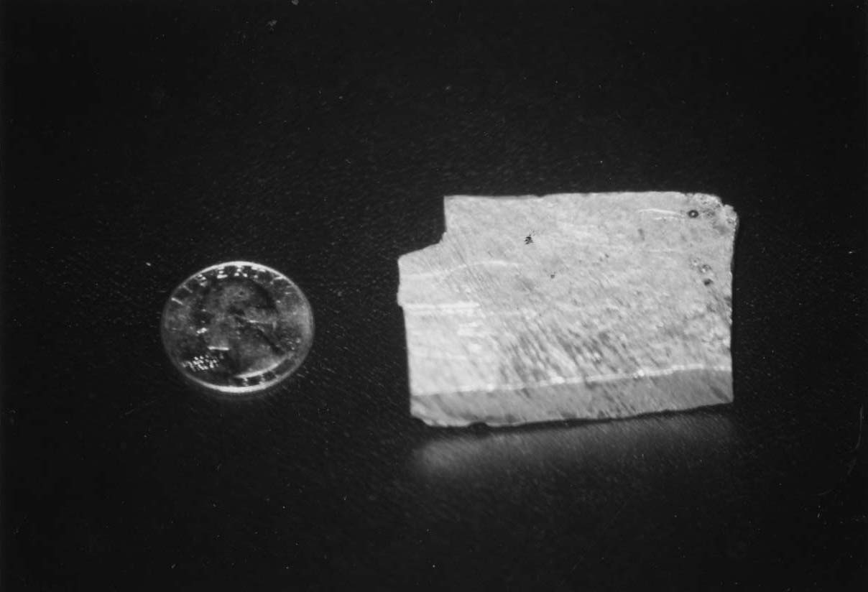
Bogota, Columbia 1975 or 1976
Witnesses: Two University students
Metallic sound heard, 4 am, raining
Disk, 12 ft diameter, in difficulty
Four other objects came over
Spouts of liquid ejected
Sample handed to me in Costa Rica
Analysis: Vallee, Puthoff (UT Austin)
93.72% Aluminum, P=4.75%, Fe= 0.91%

Slide 13
Council Bluffs, Iowa 17 December 1977
Witnesses: Eleven, in several groups
Hovering red object with lights around
Metal ejected, fell on levee, in molten state for hours
Police and investigators on site immediately
Samples given to us by case investigators, chain of custody
Classical explanations ruled out after investigation
Major component: iron (Fe)
Other elements: nickel, chromium, manganese, silicium and titanium

Slide 14
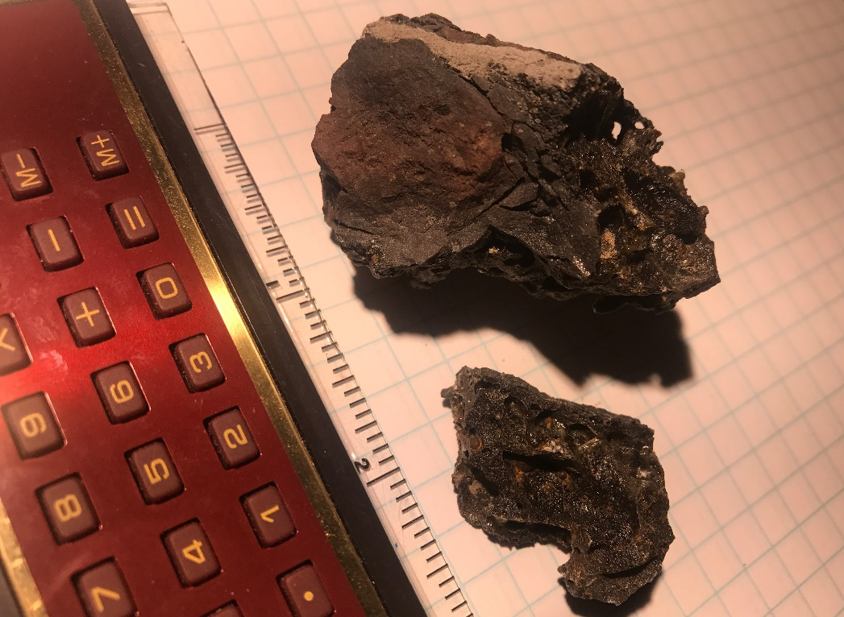
Council Bluffs case details
Site: levee in Big Lake park
Time: 7:45 pm on 17 December 1977
Weather: 2,500 ft ceiling, visibility 10 miles temperature 32 deg. F, wind from WNW 16 mph, gusts to 25 mph.
Metal was “running, boiling down” (police on site within minutes)
Remained warm to the touch for two hours

Slide 15
Hypothesis A: Hoax by persons pouring metal ?
Every metal firm in the area was checked
Griffin Pipe has product capability
Works manager Mr. Linton Stewart stated melting point of carbon steel is 2,500 degrees F.
It would have to be transported in special oven with a large truck
Conclusion: NOT A HOAX

Slide 16
Hypothesis B: Hoax by persons using thermite ?
Material was in molten state as witnesses arrived
Ground was frozen to a depth of 4 inches
The air was at 32 degrees F
Water cooling would have generated ice
No source of thermite in the area
Conclusion: NO THERMITE WAS USED

Slide 17
Hypothesis C: Material falling from aircraft ?
Proximity to Eppley Airfield (10mi) and Offutt AFB (30 mi) noted
No abnormal aircraft activity at the time
Airlines stated they had no landing at the time
Aircraft would be low, falling metal could not be warmed up by
the atmosphere to a molten state.
Even B-52s don’t carry large furnaces…
Does not explain glowing disk seen
Conclusion: DID NOT FALL FROM A/C

Slide 18
Hypothesis D: Space debris ?
Air Force Space Systems contacted
reentering debris is not molten when it hits
This 35 to 40-pound mass left no indentation
visual sighting was at altitude 500 to 600 ft where debris would not be glowing
no structural indication found
Conclusion: NOT SPACE DEBRIS

Slide 19
Hypothesis E: Meteorite impact ?
No significant crater
Material in molten state for hours
Low nickel composition
Incompatible with meteoritic nature
Conclusion: NOT A METEORITE
THE CASE REMAINS UNIDENTIFIED

Slide 20
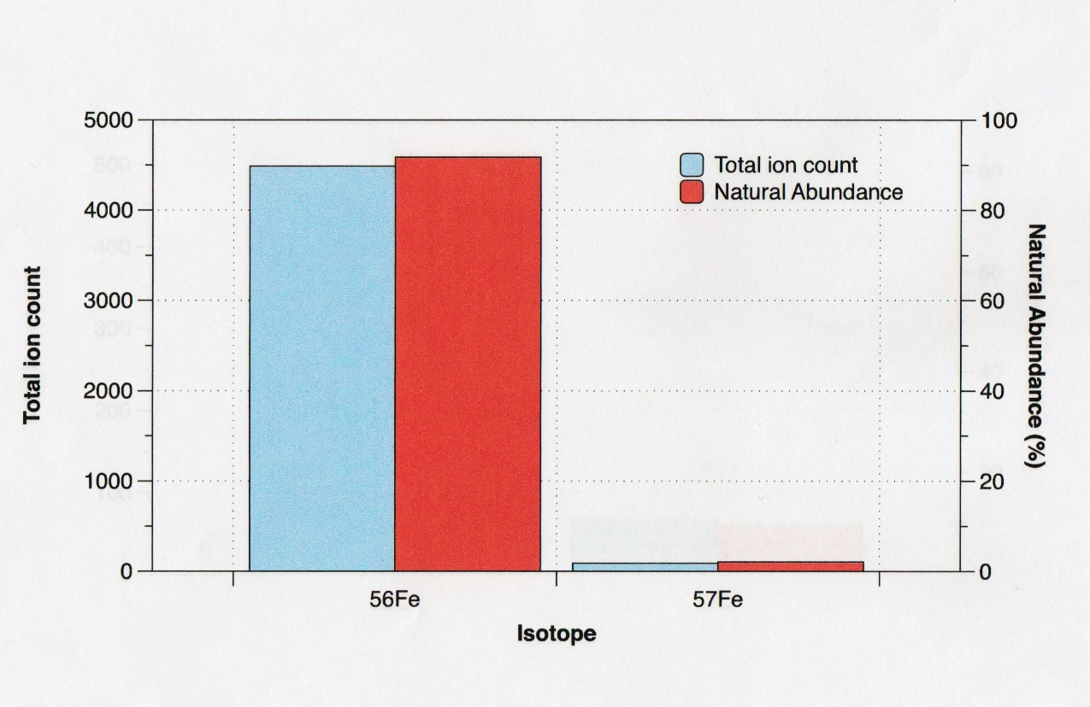
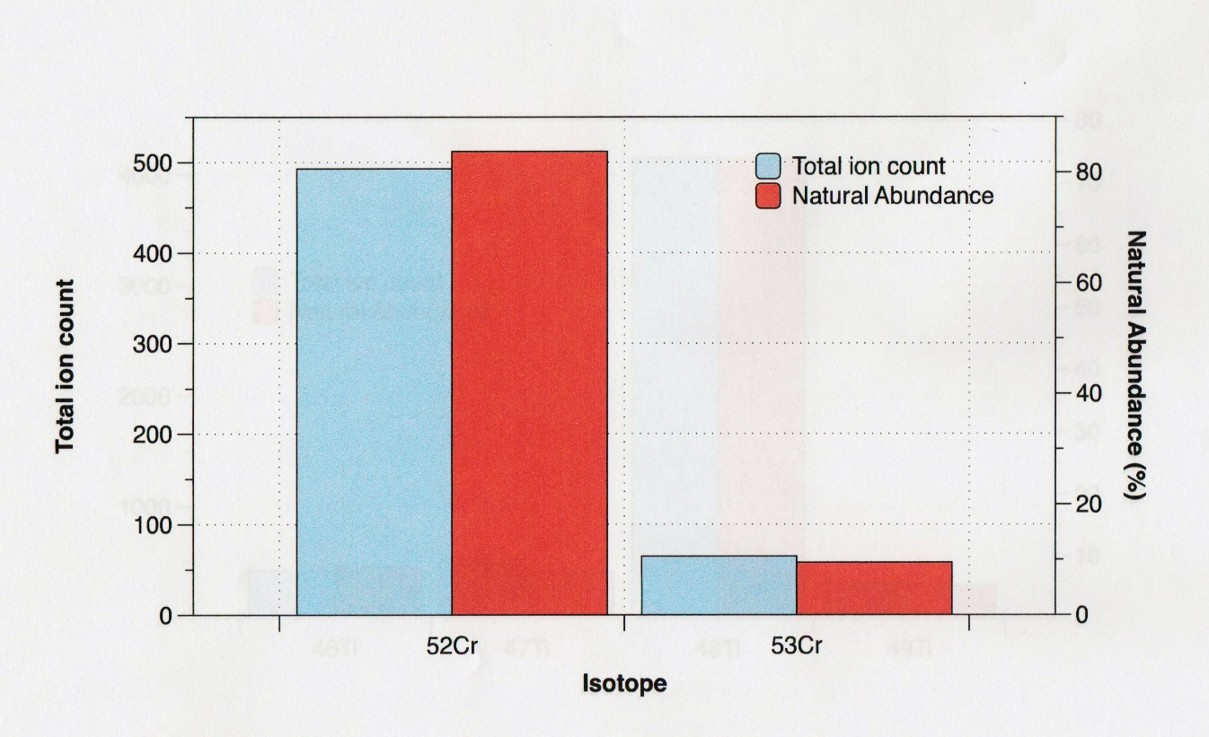
Council Bluffs : Iron & Chromium at normal levels
(but more work needed)
Isotopes of Iron
Isotopes of Chromium

Slide 21
More about Ubatuba: Colorful history
History of Samples:
In Sept.1957 Columnist Ibrahim Sued (O Globo) received three fragments in a letter from an eyewitness. Dr. Olavo Fontes cut sample 1 into subpieces for studies in Brazil Govt. laboratories.
One subpiece went to the Mineral Production Laboratory where chief chemist Dr. Feigl did the first analysis. Another subpiece went to Dr. Louisa Laria Barbosa who did spectrographic analysis. Dr. Elysuario Tavora Filho of the Crystallography lab did x-ray diffraction.
Fragments 2 and 3 were not tested in Brazil, unfortunately.
Fragment 2 was sent to APRO in Arizona and subpieces were tested at Oak Ridge, Dow Chemical and the USAF, who destroyed their sample accidentally (and asked for more!)
Fragment 3 was sent to the Colorado (Condon) UFO project
Later APRO also sent subpieces to Dr. Sturrock at Stanford.
One sample was stolen from his safe deposit bank vault…
Density Anomaly:
Dr. Olavo Fontes has reported that a chemist named A. Batista, from the Laboratory of Crystallography, determined the density to be 1.866 g/cc versus 1.741 g/cc for terrestrial magnesium, suggesting a higher concentration of the heavier isotopes of magnesium, Mg25 and Mg26, normally representing 10.1% and 11.3% of the element, respectively.
Density was measured on a small chip from the center of « Sample 1 » that was carefully polished to eliminate contamination.
If the sample was entirely composed of Mg26 the density would be 1.862 (Paul Hill, 1995) matching the measurement.
The Condon report challenges this conclusion, however
Unfortunately « Sample 1 » was destroyed in Brazil.

Slide 22
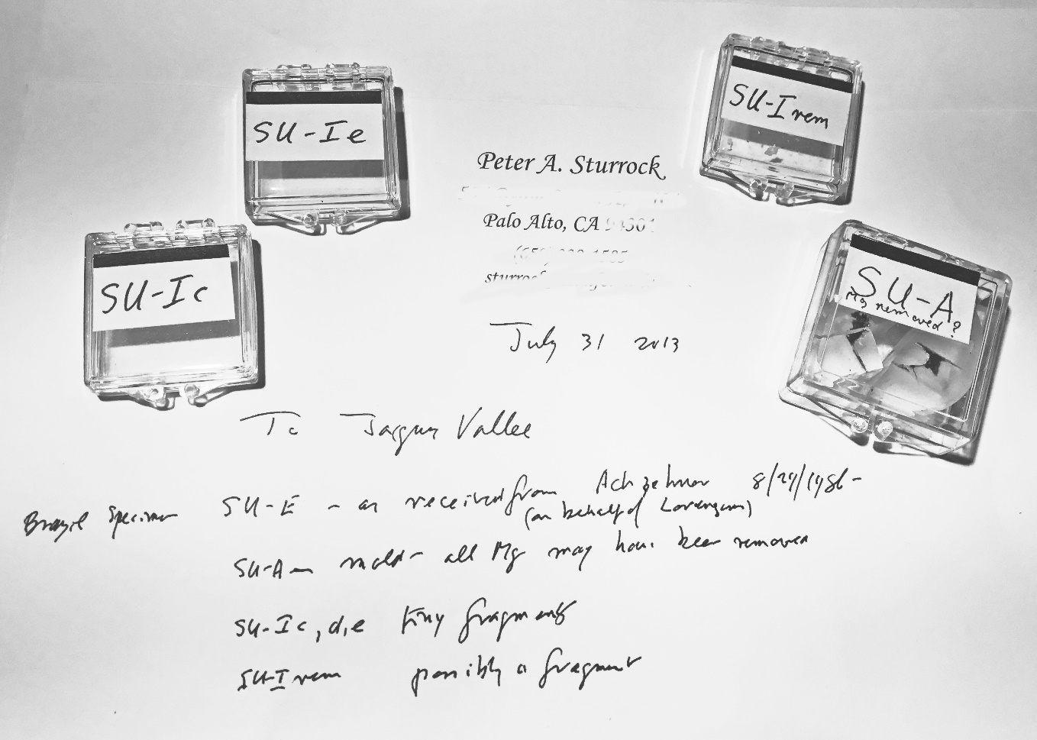
Ubatuba: Status of surviving samples
The samples shown on the right are among those that were transmitted to JV by Professor Sturrock in July 2013.
Selected portions of these materials (and others) were extracted and mounted for new analyses.

Slide 23
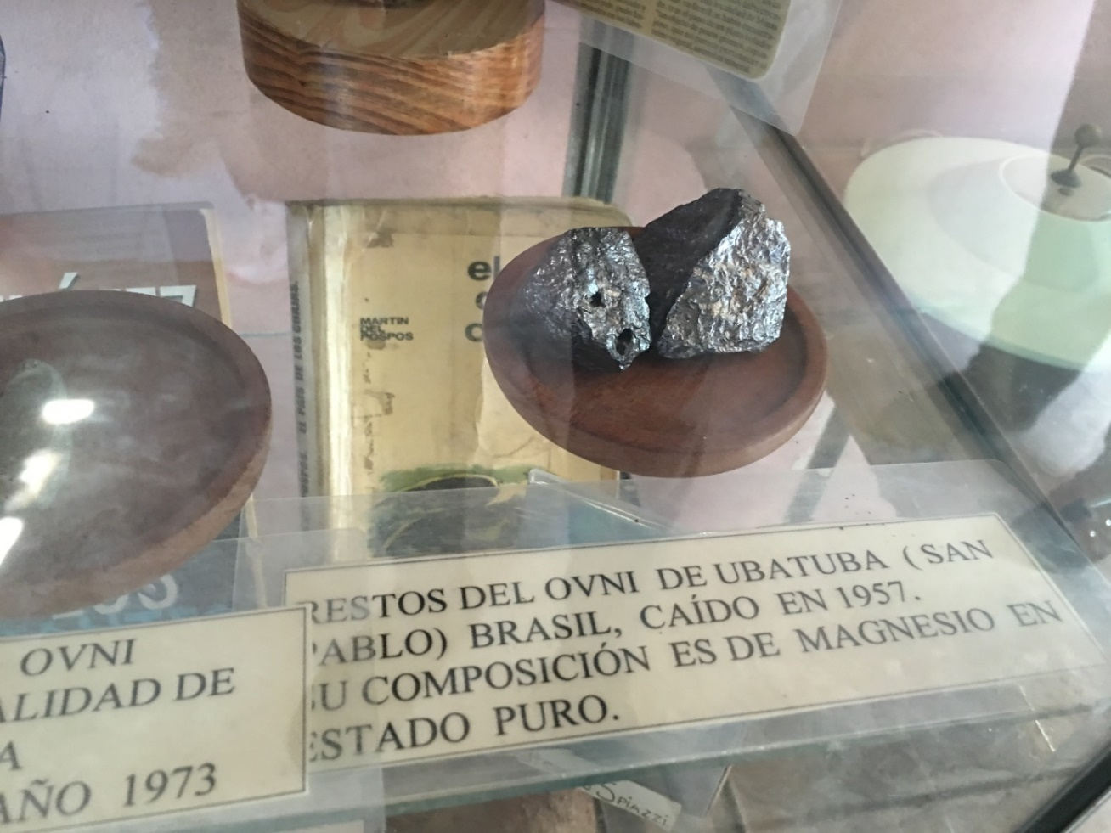
Ubatuba: Two more samples found
While in Argentina in Sept. 2016
JV visited a site in Victoria (Entre Rios) that preserved two samples from Ubatuba:
One from Dr. Olavo Fontes (« Muestra-A ») through Sr. Nicolas Ojeda
The other (« Muestra-B ») from an Argentinian sailor named Hercente.

Slide 24
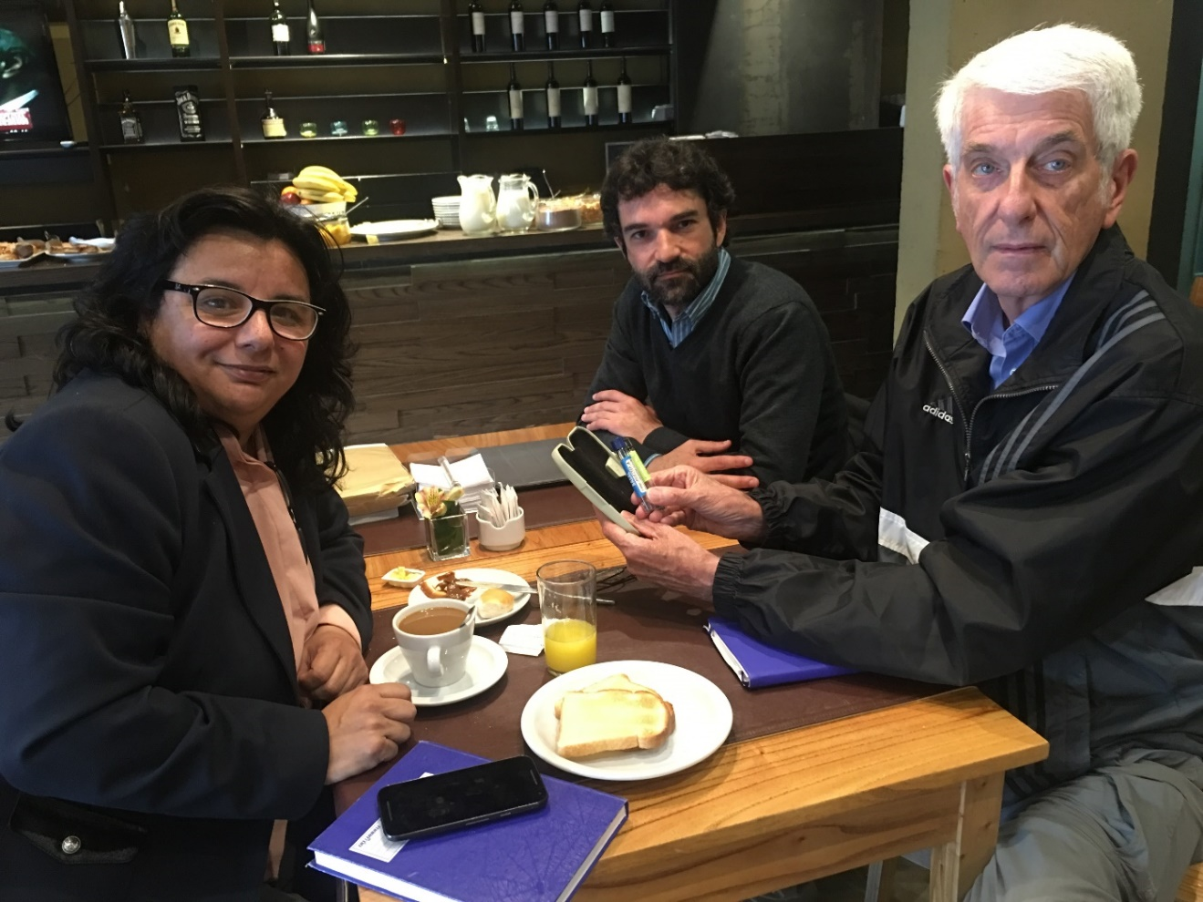
Chain of custody: Buenos Aires, 2016
Sra. Andrea Simondini brought portions of both samples (Muestra-A and Muestra-B) from the depository to Buenos Aires on 21 September 2016.
They remained in JV’s custody as he flew back to San Francisco.

Slide 25
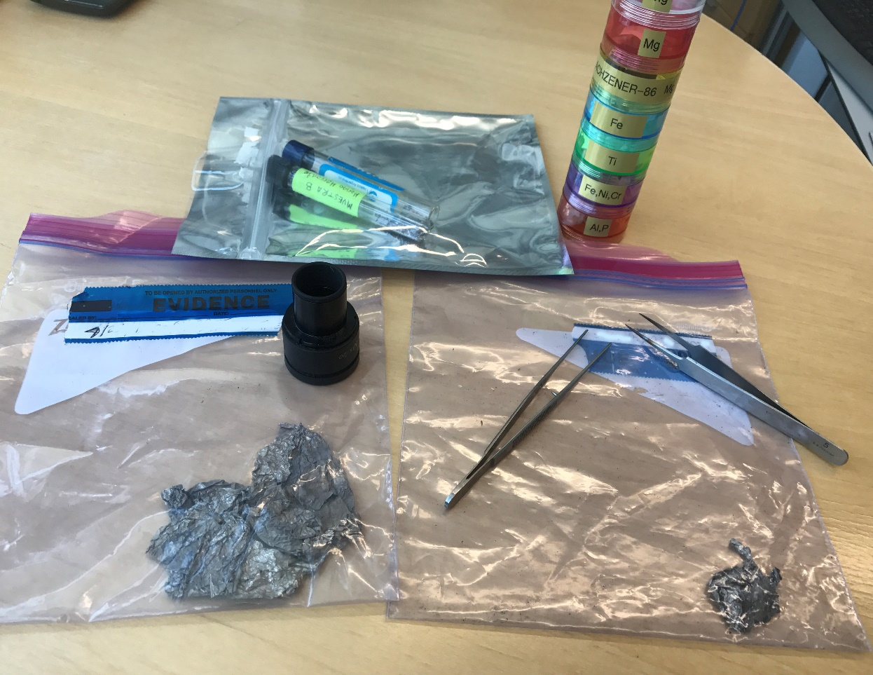
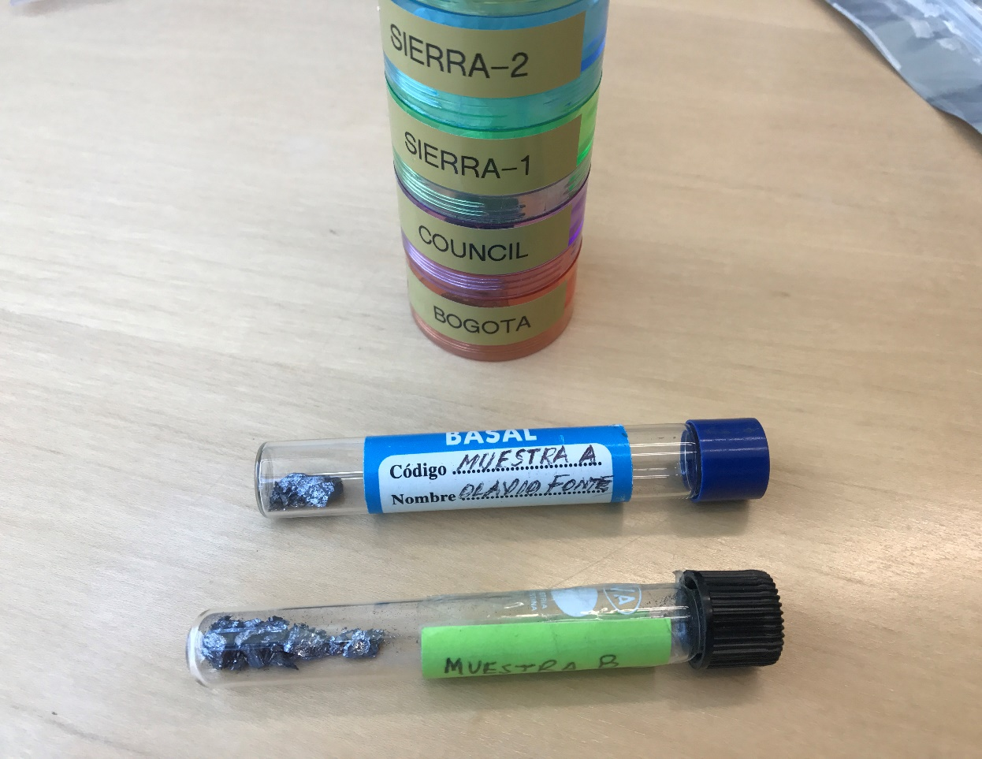
The next step : Back to the Nolan private Lab

Slide 26
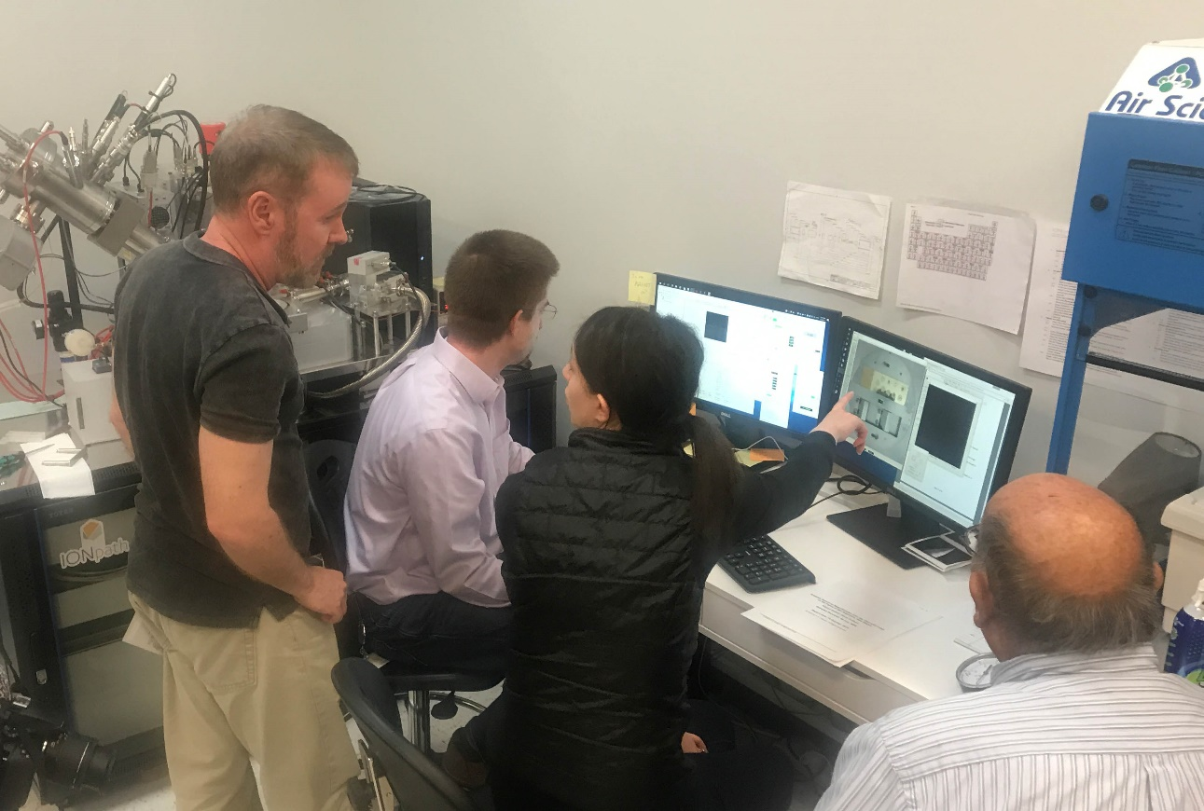
New instrumentation in Silicon Valley
A Silicon Valley startup made its instruments available for testing of unknown samples
The technique can identify elements and their isotopes with high precision.

Slide 27
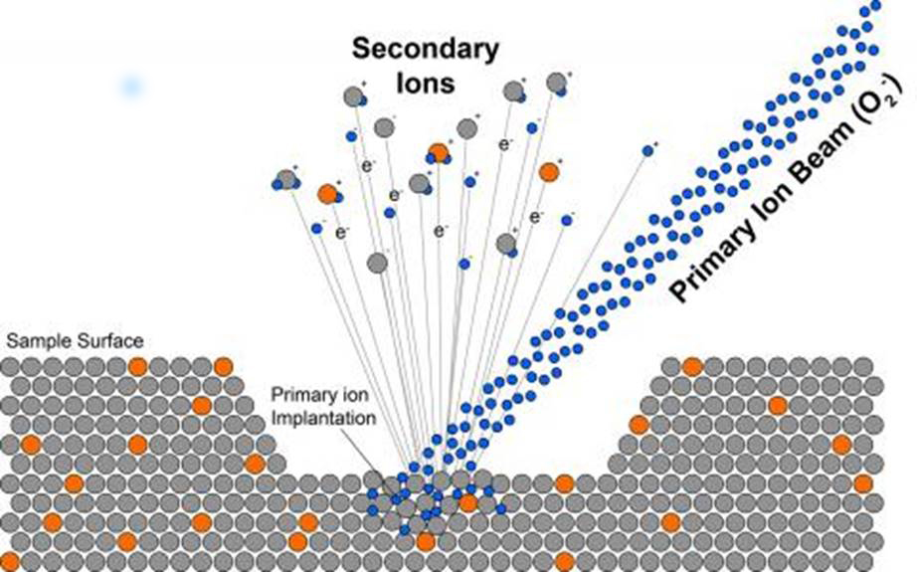
Technology: secondary ion mass spectroscopy

Slide 28
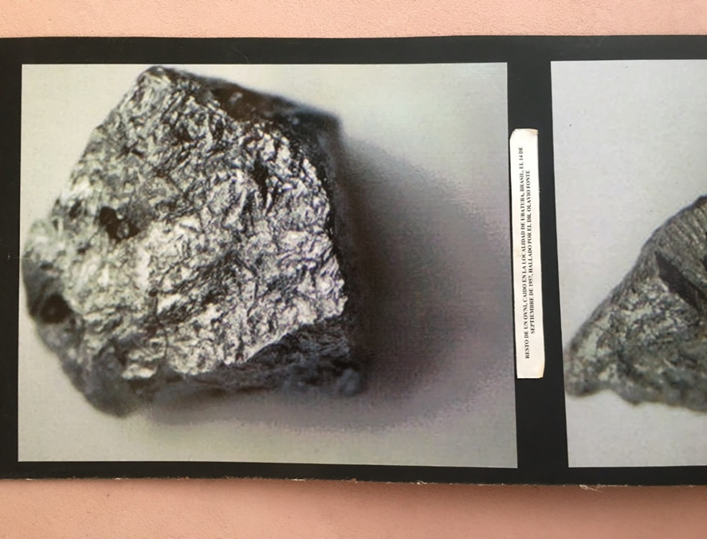
The Mg Isotope Ratios of the “MUESTRA-A”
Ubatuba sample are natural
(Muestra – A from Dr. Fontes)
Isotope
Natural
Shard 1
Shard 2
Mg(24) | 78.9 | 80%
Mg(25) | 10 | 9%
Mg(26) | 11.1 | 11%
80%
9%
11%
Ratios appear to be the same as Terrestrial.
The material also contains silicon and sodium

Slide 29
The Mg Isotope Ratios of the “Muestra-B”
Ubatuba sample are (apparently) non-natural
(Muestra – B is from Sr. Hercente)
~100 nanometers
into shard…
Isotope
Natural
Shard 3a
Shard 3b
Mg(24) | 78.9 | 66%
Mg(25) | 10 | 15%
Mg(26) | 11.1 | 20%
67%
16%
17%
Ratios are significantly different from “Terrestrial” standard.
The material also contains silicon and sodium.

Slide 30
Caveats
Both samples appear to be heavily contaminated with Silicon
  Molten Mg mixing with silicon in sand?
  This would be consistent with witnesses’ statements
Significant levels of Sodium
  Seawater salt?
  This observation is also consistent with fishermen’s testimony
  Next step: Redo ALL Ubatuba analyses from surviving samples

Slide 31
Ubatuba References
Sued, I.: Um fragment de disco-voador! Rio de Janeiro: El Globo 14 Sept.1957 p.4.
Fontes, Olavo T.: Physical Evidence: A report on the investigation of magnesium samples from a UFO explosion over the sea in the Ubatuba region of Brazil. In Lorenzen, C.: The Great Flying Saucer Hoax. NY: William-Frederick Press, pp. 89-132 (1962).
Condon, E.U. and Gillmore, D.S.: Scientific Study of Unidentified Flying Objects. NY: Bantam Press (1969).
Lorin, J.C. and Havette, A. Isotopic and Elemental Characterization of a Magnesium Sample of Unknown Origin Collected in Brazil in 1957. Laboratoire de Minéralogie–Cristallographie, Université P. et M. Curie, Paris, France, 1986.
Swords, M.D.: Analysis of alleged fragments from an exploding UFO near Ubatuba, Brazil: An introduction.
Journal of UFO Studies (new series) 4, 1-5 (1992).
Walker, W.W. and Johnson, R.W.: Further studies of the Ubatuba UFO magnesium samples.
Journal of UFO Studies (new series) 4, 6-25 (1992).
Walker, W.W. and Johnson, R.W.: Scientific studies of the Ubatuba magnesium fragments.
Journal of UFO Studies (new series) 4, 26-37 (1992).
Vallee, Jacques F.: Physical Analyses in ten cases of unexplained aerial objects with material samples.
Journal of Scientific Exploration (“JSE”) Vol.12, no.3, pp.359-376 (1998).
Sturrock, Peter A.: Composition Analysis of the Brazil Magnesium. JSE Vol.15, no.1, pp.69-95 (2001).
Kaufmann, P. and Sturrock, P.A.: On Events possibly related to the « Brazil Magnesium » JSE Vol.18, no.2 pp.283-291 (2004).

Slide 32
The “Sierra-1” case: Titanium
Composition
Titanium: 99.35% of weight
Al: 4020 ppm
Si: 755 ppm
Fe: 561 ppm
Mg: 321 ppm
V: 202 ppm
Cr: 197 ppm
Mn: 136 ppm
Ni: 137 ppm
Ca (73 ppm) and K (16 ppm)
Isotopes
Ti46 standard: 8.25% Sample: 8.70 and 7.66
Ti47 7.44% 5.33 and 3.83
Ti48 73.72% 73.91 and 76.56
Ti49 5.41% 6.30 and 6.70
Ti50 5.18% 5.76 and 5.26

Slide 33
The “Sierra-2” case: Iron
Composition
Iron: 98.55% of weight
Mn: 8543 ppm
Cr: 3500 ppm
Cu: 1032 ppm
Ni: 613 ppm
Si: 592 ppm
Co: 94 ppm
Zn: 76 ppm
Al: 63 ppm
Ca (10 ppm) and V (7 ppm)
Isotopes (TBD)

Slide 34
Summary of Findings / Next steps
Certain metal materials are seen to contain trace levels of elements (and isotopes of said elements) which no man-made or terrestrial metals would be expected to contain. Are these contaminants or purposefully introduced (engineered)?
The technical analysis needs to be expanded through the use of several instruments to arrive at more precise composition tables.
No analysis from a single instrument or method is fully reliable.
3. We plan an aggressive program of search for additional samples
in order to reach a general picture of the entire problem.
4. Abnormal isotope ratio DOES NOT MEAN: ET origin!

Slide 35
General References
Hill, Paul: Unconventional Flying Objects: A scientific analysis. Charlottesville: Hampton Roads (1995). See pp. 226-237.
Lebelson, Harry: « UFO Update – Alien Metals » in Omni pp.130-132 (Nov. 1979)
Vallee, Jacques F.: Confrontations – A Scientists’s Search for Alien Contact. NY: Ballantine (Appendix, pp.231-244) (1990).
Schuessler, John: « Recognizing ‘Alien’ Metal ». UFO Potpourri no.391 (July 1995).
Hansen: Constitution of Binary Alloys.
TO BE CONTINUED

